Slide 1
Static Analysis of NodeJS

Slide 2

Hello!
I am Raja Sekar Durairaj
Full stack developer @BNY Mellon Tech Pvt Ltd
Read lot of things and write few thigns in medium blog
https://medium.com/@rajsek

Slide 3
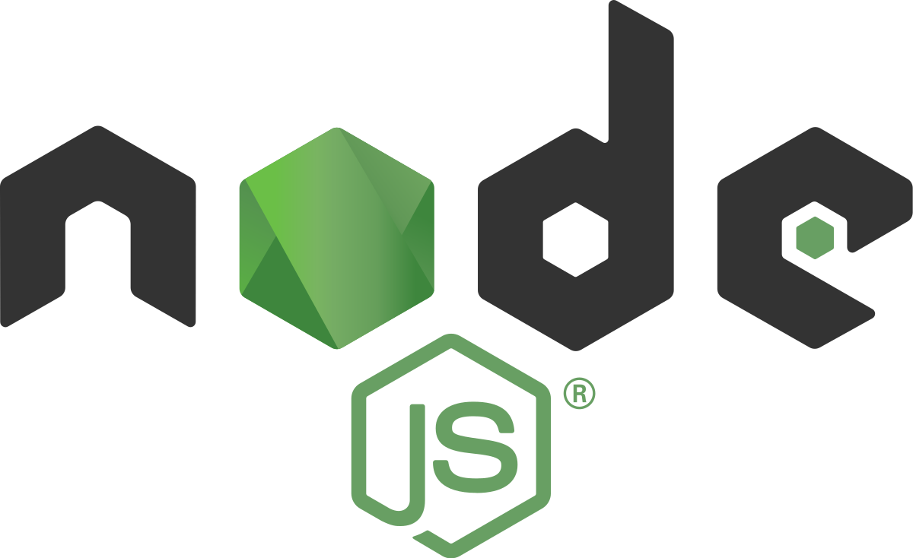
Big Picture
Things we cover today
What NodeJS & Why Node js?
Some Benchmark between node js & other framework - 5 min
Confusing Nodejs (WTF js?) – 5 min
Code Review
Securing Credentials &Password Policy
Securing Routs and logs
Managing Untrusted data injection
Preventing XSS and CSRF Attacks
Vulnerabilities in NPM Packages
Preventing Brute-Force & Denial-of-Service Attacks
Errors handling

Slide 4
What & Why ?
What is ?
“Node.js® is a JavaScript runtime platfrom built on Chrome's V8 JavaScript engine and it uses an event driven, non-blocking I/O model that makes it lightweight and efficient.”
Why ?
Node is not just a language. It is an ecosystem. It uses versatile javascript as programing language, which help us to build in many platforms
Web UI (react,Angular,Vew), Backend Service (express, hapi).
Tooling/Cli and automated testing (phantomjs.org)
Mobile (react native)
Desktop (Electron – skype, slack, VS-code and etc)
IOT

Slide 5
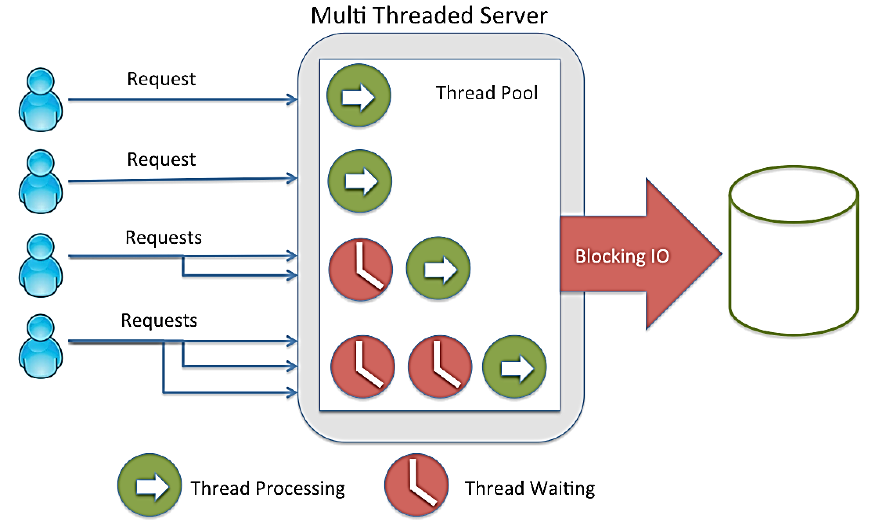
Multi Threaded Server
const fs = require('fs');
// blocks here until file is read
const data = fs.readFileSync('/file.md');
// moreWork(); will run after console.log
console.log(data);

Slide 6
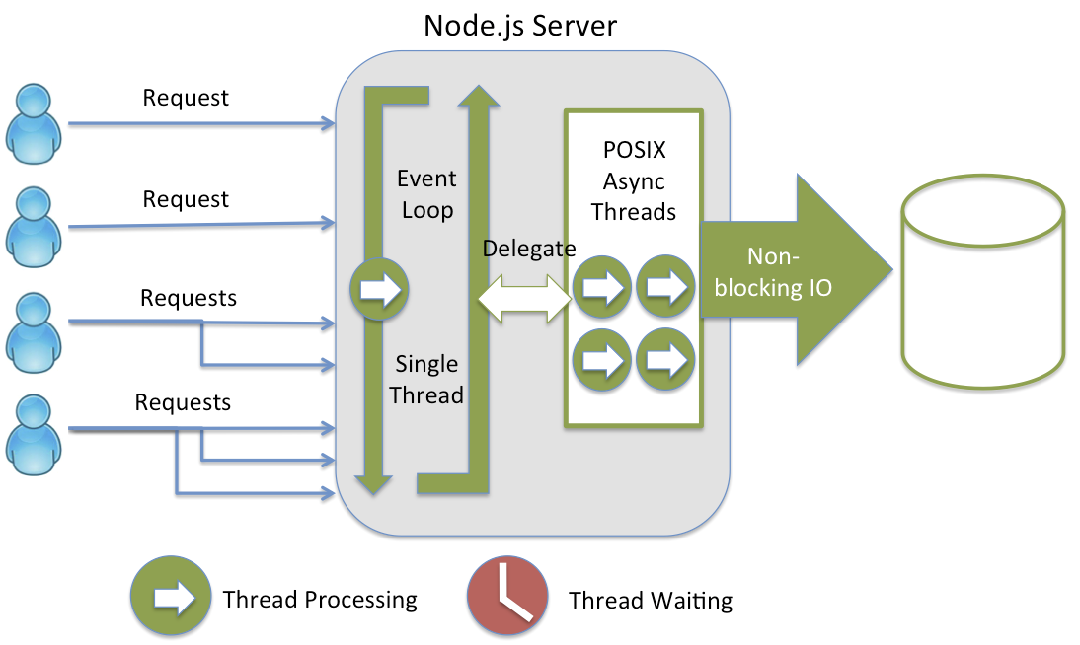
Node.JS Server
const fs = require('fs');
fs.readFile('/file.md', (err, data) => {
if (err)
throw err;
console.log(data);
});
// moreWork(); will run before console.log

Slide 7
Multi Threaded Server VS Node.JS Server

Slide 8
Before you ‘assume’, try this crazy method called ‘console.log’

Slide 9
Some WFT JS moments
0.2+0.1 != 0.3 and 038 - 037 === 7
Cases like “Truthy, but not true”
Cases like “Falsy, but not false”
Minimal value is greater than zero
Array equality is a monster
Comparing null to 0
if true == [] is false,
then what is “true == ![]” // -> false
If !!null is false,
then null == false; ?// -> false
Number.MIN_VALUE > 0 ? true
[] == '' // -> true (a=b)
[] == 0 // -> true (a=c)
[0] == 0 // -> true (d=c)
[0] == '' // -> false (d=b)
null == 0; // -> false
null > 0; // -> false
null >= 0; // -> true

Slide 10
Some More WTFJS
parseInt is a bad guy
Magically increasing numbers
Number.toFixed() display different numbers
Math.max() less than Math.min()
If parseInt(0.000001); // -> 0, then why
parseInt(0.0000001); // -> 1
parseInt(1 / 1999999); // -> 5
999999999999999; // -> 999999999999999
9999999999999999; // -> 10000000000000000
10000000000000000; // -> 10000000000000000
10000000000000000 + 1; // -> 10000000000000000
10000000000000000 + 1.1; // -> 10000000000000002
(0.7875).toFixed(3);
// Firefox: -> 0.787 // Chrome: -> 0.787 // IE11: -> 0.788
(0.7876).toFixed(3);
// Firefox: -> 0.788 // Chrome: -> 0.788 // IE11: -> 0.788
null == 0; // -> false
null > 0; // -> false
null >= 0; // -> true

Slide 11
Some WFT JS moments
0.2+0.1 != 0.3 and 038 - 037 === 7
Cases like “Truthy, but not true”
Cases like “Falsy, but not false”
Minimal value is greater than zero
Array equality is a monster
Comparing null to 0
if true == [] is false,
then what is “true == ![]” // -> false
If !!null is false,
then null == false; ?// -> false
Number.MIN_VALUE > 0 ? true
[] == '' // -> true (a=b)
[] == 0 // -> true (a=c)
[0] == 0 // -> true (d=c)
[0] == '' // -> false (d=b)
null == 0; // -> false
null > 0; // -> false
null >= 0; // -> true

Slide 12
Suggested way to handle those issue
Follow typing thorough Typescript or flow or any other
Be extra careful when comparing two different types (number to array, array to Boolean)

Slide 13

Vulnerabilities in NPM Packages
The attacker used a technique called "typo-squatting" to register packages with names similar to popular libraries
validator.js != validator
2017 -NPM packages caught stealing environment variables
Loading unwanted packing( increases code side .
Use es6 Import
import {isNum} from ‘SomeUtil’ vs
import * from ‘SomeUtil’

Slide 14
Securing Credentials &Password Policy (Inspecting config files)
Storing secrets and password in plain text
Logs are added in public route
Logging secrets , server details in config in plain text
Use encode/hashing technique

Slide 15
Managing Untrusted data injection
Trusting a user data leads to injections
Use lib like express-sanitizer
Use Content-Security-Policy
Prevent CSRF Attacks and secure cookies
Never use GET for transaction
Include nonce that much validate form handler endpoint
Secure Cookies
Set cookies = true in express session
httpOnly =true in cookie property

Slide 16
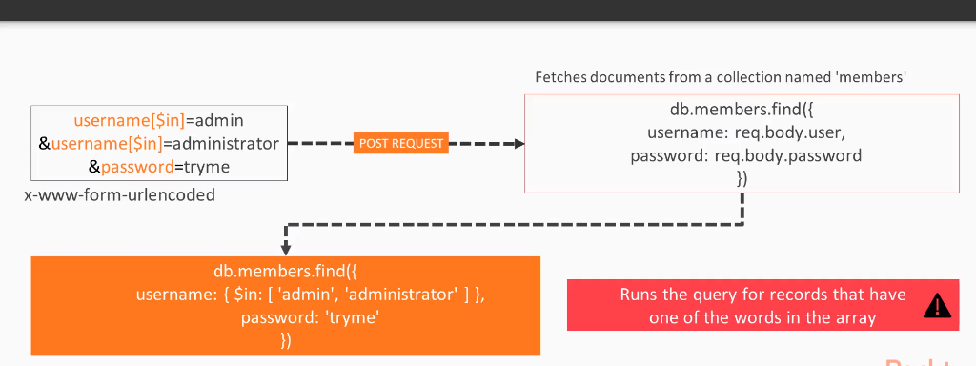
Managing Untrusted data injection

Slide 17
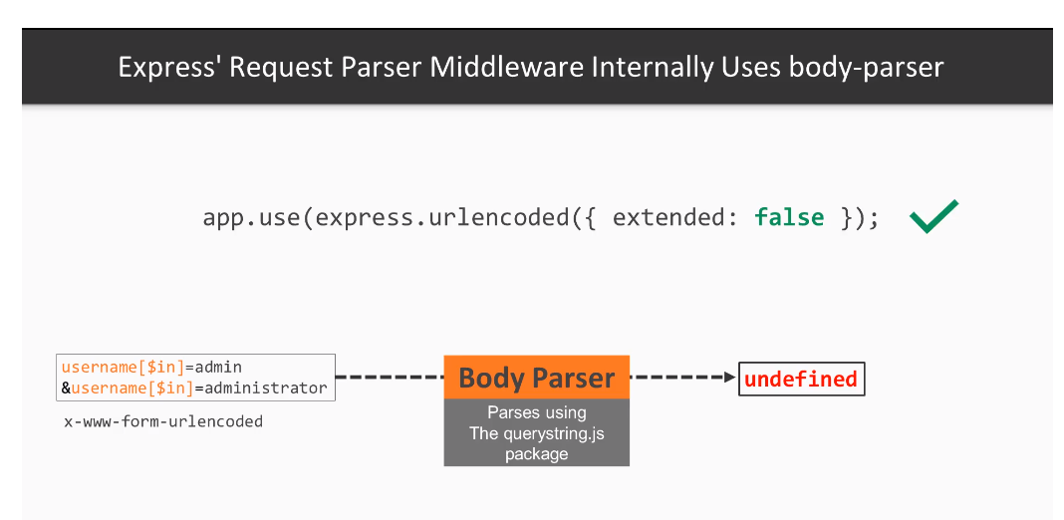
Default body-parser cause injection

Slide 18
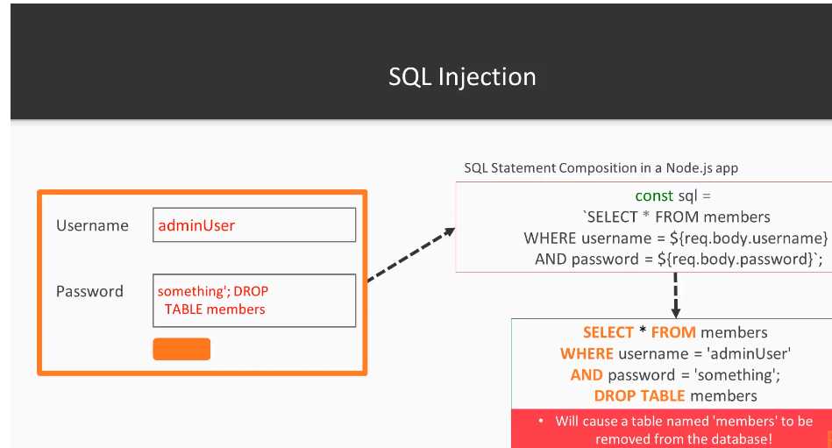
String Sql Statement

Slide 19
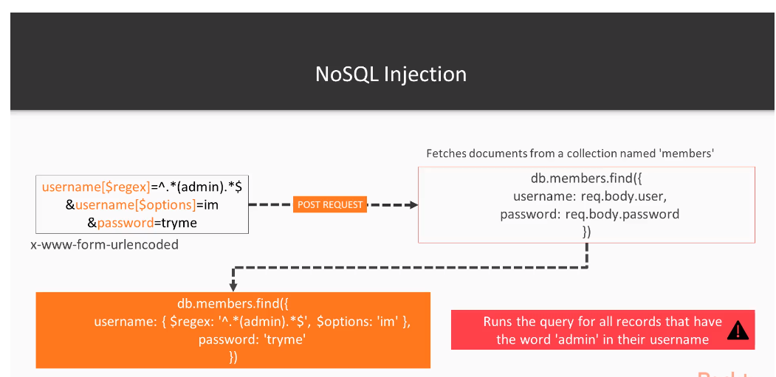
No-Sql Statement

Slide 20
Final Note
Logs are added in public route
Check all Route and its access through passport or other authorization library
Logging secrets , server details in config in plain text
Use encode/hashing technique
Never re-throw the application error to end user
User named sql templated instead of sql statement usign strings
Use Hashing

Slide 21
Thanks!
Any questions?
You can find me at fb.me/rajsek

